Slide 1


PIF Crimes – Enhancing judicial and legal cooperation to safeguard the EU’s financial interests
Lorenzo Bernardini
17 July 2025

Slide 2
SESSION I
Introduction to the Directive 2017/1371 (“PIF Directive”) and relevant CJEU case law
Notes:
Deepen knowledge of the PIF Directive

Slide 3
OUTLINE
Introductory remarks
The evolution of the notion of “fraud to financial interest of the EU” and of the EU legal framework
PIF directive and offences
Roundtable on CJEU case law
The role of EPPO

Slide 4
INTRODUCTORY REMARKS
Protecting the Union’s financial interests against fraud is a key element of the EU policy agenda since 1970s.
Goal: ensuring the sound and efficient management of EU budget and funds through every instruments at our disposal – including criminal law.
The ECJ case law has actively contributed to the evolution of the notion of “fraud to financial interests” and, consequently, of the EU legal framework.
Notes:
Decision no 70/243/CECA du Conseil, 21 avr. 1970: CEE si dota di un suo proprio budget.
Fraud affecting EU’s budget threatens EU’s own existence!

Slide 5
THE EVOLUTION OF THE CONCEPT OF PIF AND OF EU LEGAL FRAMEWORK
It is possible to distinguish 3 different periods:
1970-1990: No EU legal framework
No relevant provision or definition of fraud against financial interests of the EU, neither in the original treaties, nor in other legislative acts.
Individual MSs had an insufficient own interest to criminalize actions to the detriment of EU financial interests.

Slide 6
THE EVOLUTION OF THE CONCEPT OF PIF AND OF EU LEGAL FRAMEWORK
1970-1990: No EU legal framework
CJCE, 21 sept. 1989 (C-68/88) Commission c/ Greece (“Greek maize” ruling)
The Court establishes the principle of equivalence and effectiveness for sanctions.
MSs are required to protect the finances of the EEC as they would their own national finances, through “effective, proportionate, and dissuasive sanctions”.

Slide 7
THE EVOLUTION OF THE CONCEPT OF PIF AND OF EU LEGAL FRAMEWORK
1990-2000
The Treaty of Maastricht (1992)
Third pillar on judicial cooperation (including criminal law).
Article 209 A enshrines the principle of equivalence: “MSs shall take the same measures to counter fraud affecting the financial interests of the Community as they take to counter fraud affecting their own financial interests”.
Notes:
The PIF sector is the “driving force for a European criminal law” (Grünewald, 2015).

Slide 8
THE EVOLUTION OF THE CONCEPT OF PIF AND OF EU LEGAL FRAMEWORK
1990-2000
The PIF Convention (1995)
First definition of “fraud against financial interests of EU”.
Article 2 : “Each MS shall take the necessary measures to ensure that the conduct referred to in Article 1 are punishable by effective, proportionate and dissuasive criminal penalties”.
Yet, persisting lack of equivalent protection against fraud across the EU.
Notes:
Convention établie sur la base de l’article K.3 du Traité sur l’Union européenne, relative à la protection des intérêts financiers des Communautés européennes, JOCE, n° C. 316, 27 nov. 1995.
Or, nonobstant les efforts déployés, ces premiers instruments se sont rapidement révélés peu dissuasifs et incapables de remédier à la fragmentation des systèmes nationaux.
In 1995, the PIF Convention came to light, being the first legal instrument requiring Member States the criminalisation of conducts of fraud that might affect the financial interests of the former European Community. The PIF Convention was the first legal instrument, which imposed criminal law obligations on Member States for the protection of the European Communities budget. Specifically, the Convention required Member States to take measures to punish conducts of fraud through criminal law sanctions. The PIF Convention, however, did not mention other practices, which could be very harmful for the financial interests of the European Communities, namely, the practices of corruption of public officials managing Communities’ funds.

Slide 9
THE EVOLUTION OF THE CONCEPT OF PIF AND OF EU LEGAL FRAMEWORK
2000-to present
Lisbon Treaty: new article 86 TFEU and article 325 TFEU.
“PIF” Directive (EU) 2017/1371 on the fight against fraud affecting the Union’s financial interests by means of criminal law (COM(2012) 363 final).
ECJ most important rulings concerning the notion of “fraud to financial interests of EU” are concentrated in this third period.
Notes:
It was not until the entry into force of the Lisbon Treaty that the lack of equivalent protection across the territory of the EU was addressed.

Slide 10
Article 325 TFEU
(1) “The Union and the Member States shall counter fraud and any other illegal activities affecting the financial interests of the Union through measures to be taken in accordance with this Article, which shall act as a deterrent and be such as to afford effective protection in the Member States, and in all the Union’s institutions, bodies, offices and agencies.
(4) The European Parliament and the Council, acting in accordance with the ordinary legislative procedure, after consulting the Court of Auditors, shall adopt the necessary measures in the fields of the prevention of and fight against fraud affecting the financial interests of the Union with a view to affording effective and equivalent protection in the Member States and in all the Union’s institutions, bodies, offices and agencies”.

Slide 11
Article 325 TFEU
New legislative competence at EU level in the PIF domain.
“(…) shall adopt the necessary measures”: including criminal law?
As it has happened in many areas of EU law, the ECJ played its part:
  enhancing the effectiveness of the fight against fraud in concreto.
  extending the notion of “fraud” from an objective point of view (VAT, Common Customs Tariff duties, irregularities having no specific financial impact).

Slide 12
ECJ case law
ECJ, C-612/2015, Kolev and Others case
Facts of the Case
Criminal proceeding brought against eight Bulgarian customer officers, who are accused of having committed corruption in custom matters.
Infringement of essential procedural requirements (right to information and to lawyer).
Bulgarian law imposes the termination of criminal proceedings if procedural infringements are not remedied within the period prescribed.
Legal question
Should Article 325 TFEU be interpreted as precluding national legislation that establishes a rule for the termination of criminal proceedings in so far as that legislation is applicable in proceedings initiated with respect to cases of serious fraud affecting the financial interests of the EU?

Slide 13
ECJ case law
ECJ, C-612/2015, Kolev and Others case
CJEU decision
“51. Under Article2(1)(a) of Decision 2007/436,own resources of the EU include, inter alia, Common Customs Tariff duties. Therefore, there is a direct link between the collection of revenue deriving from those duties and the availability to the EU budget of the corresponding resources. Any failure in the collection of the former potentially causes a reduction in the latter”.
“52. Accordingly, in order to ensure the protection of the financial interests of the Union, MSs are obliged to adopt the measures necessary to guarantee the effective and comprehensive collection of customs duties”.
“65. It is therefore for the national legislature to amend the legislation and to ensure that the procedural rules applicable to the prosecution of offences affecting the financial interests of the EU are not designed in such a way that there arises, for reasons inherent to those rules, a systemic risk that acts that may be categorized as such offences may go unpunished, and also to ensure that the fundamental rights of accused persons are protected”.

Slide 14
ECJ case law
ECJ, C-310/2016, Peter Dzivev case
Facts of the Case
The judgment concerned a request for a preliminary ruling from a criminal court in Bulgaria, in a proceeding for VAT evasion.
The court noted that interception of the defendants’ telecommunications had been authorised by a court that no longer had jurisdiction after reform of the Bulgarian Code of Criminal Procedure in 2012.
Only the interceptions of telecommunications clearly establish the commission of the tax offences Dzivev was accused of.
Legal Question
Do Article 325 TFEU – read in the light of the principle of effective prosecution of VAT offences – restrict the applicability of national rules on the inadmissibility of illegally obtained evidence (here: wiretapping)?
Notes:
The interceptions fell into a transitional phase before and after the reform of the Code of Criminal Procedure transitional rules remained unclear that governed the transfer of jurisdiction to courts competent to authorise “special investigation methods” after the reform.

Slide 15
ECJ case law
ECJ, C-310/2016, Peter Dzivev and Others case
CJEU decision
The procedure for taking evidence and the use of evidence in VAT-related criminal proceedings is within the competence of the Member States;
Member States must, however, counter fraud and other illegal activities affecting the EU’s financial interests through effective and deterrent measures;
There is a direct link between collection of VAT revenue (in compliance with the EU law) and the availability of corresponding VAT resources to the EU budget;
Criminal penalties may be essential in order to combat certain serious cases of VAT evasion in an effective and dissuasive manner as required by the PIF Convention;
Infringements of EU law must be penalised under (procedural and substantive) conditions, which are analogous to those applicable to infringements of national law of a similar nature and importance; in any event, these conditions must make the penalty effective, proportionate and dissuasive;
Rules of national criminal procedure must permit effective investigation and prosecution of offences linked to such conduct.

Slide 16
ECJ case law
ECJ, C-310/2016, Peter Dzivev and Others case
CJEU decision
“30. Even though the penalties and administrative and/or criminal procedures relating to those penalties established by Member States in order to counter infringements of harmonized VAT rules fall within their procedural and institutional autonomy, that autonomy is nevertheless limited by the principle of effective”.
National courts may be obliged to disapply national provisions which prevent the application of effective and deterrent penalties in connection with (criminal) proceedings concerning serious VAT infringements.

Slide 17
ECJ case law
ECJ, C-310/2016, Peter Dzivev and Others case
CJEU decision
The CJEU stressed, however, that these obligations have their limits: “33. the effective collection of the European Union’s resources does not dispense national courts from the necessary observance of the fundamental rights guaranteed by the Charter and of the general principles of EU law.”
35. In that regard, it follows that the exercise of the power to impose penalties cannot take place, as a matter of principle, outside the legal limits within which an administrative authority is authorised, in accordance with the law of the Member State by which it is governed, to act.
39. It follows that EU law cannot require a national court to disapply such a procedural rule, even if the use of that evidence gathered unlawfully could increase the effectiveness of criminal prosecutions enabling national authorities, in some cases, to penalise non-compliance with EU law.
Notes:
The judgment summarises the cornerstones of CJEU case law in relation to the protection of the EU’s financial interests. Recent judgments (see above) clarified the borders between procedural and institutional autonomy of the Member States when countering fraud affecting the EU’s financial interests and common obligations stemming from EU law, including the principles of effectiveness, proportionality, and equivalence. The judgment is a further “brick in the wall” as regards the question of which procedural rules remain untouched by EU law. After the impact of res judicata in XC and Others (C-234/17, cf. eucrim 3/2018, p. 142), the CJEU has added the rules on exclusion of evidence to those important principles of national procedural law that precede the effectiveness of EU law.

Slide 18
Proposal for a Directive on the fight against fraud affecting the Union’s financial interests by means of criminal law (COM(2012) 363 final)
Harmonization of criminal law rules concerning crimes affecting the Union’s budget and funds.
The PIF Directive (EU) 2017/1371 was finally adopted on 25 April 2017.
Surprisingly, the legal basis is Article 83(2) TFEU and not Article 325 TFEU.
Notes:
The choice of the legal basis was the most controversial point during the negotiations.

Slide 19
PIF DIRECTIVE AND OFFENCES
Article 83 TFEU
(1) “The European Parliament and the Council may, by means of directives adopted in accordance with the ordinary legislative procedure, establish minimum rules concerning the definition of criminal offences and sanctions in the areas of particularly serious crime with a cross-border dimension (…). These areas of crime are the following: terrorism, trafficking in human beings and sexual exploitation of women and children, illicit drug trafficking, illicit arms trafficking, money laundering, corruption, counterfeiting of means of payment, computer crime and organised crime.
(2) If the approximation of criminal laws and regulations of the Member States proves essential to ensure the effective implementation of a Union policy in an area which has been subject to harmonisation measures, directives may establish minimum rules with regard to the definition of criminal offences and sanctions in the area concerned.”
Notes:
Le choix final de baser la directive sur l’article 83(2) limite en quelque sorte sa portée et ses effets potentiels.
La conséquence la plus évidente est celle relative à l’instrument juridique adopté : une directive par opposition à un règlement qui aurait légitimé une juridiction pénale euro-unitaire complète et directe. Il semble évident, ainsi que mis en avant dans certains rapports et études, que ce dernier aurait constitué un instrument plus efficace pour la protection des intérêts financiers en cause. En effet, l’adoption d’un règlement aurait eu comme avantage principal son application directe et uniforme dans tous les États membres, un tel avantage ne se retrouve pas avec une directive qui nécessitera une transposition en droit interne.
La décision du législateur supranational a donc été orientée vers l’outil normatif le moins perturbant, bien que controversé, dans le but d’énoncer des dispositions minimales sur la définition des infractions et des mesures punitives.

Slide 20
PIF DIRECTIVE AND OFFENCES
The directive provides common definitions of a number of offences against the EU budget and funds (« PIF offences »).
Article 2 – Definitions and scope
Financial interests of the EU means all revenues, expenditure and assets covered by, acquired through, or due to:
  the Union budget;
  the budgets of the Union institutions, bodies, offices and agencies established pursuant to the Treaties or budgets directly or indirectly managed and monitored by them.

Slide 21
PIF DIRECTIVE AND OFFENCES
Fraud affecting the Union‘s financial interests
–in respect of (other) expenditures(Article 3(2)a))
–in respect of procurement related expenditures (Article 3(2)b))
–in respect of (other) revenues(Article 3(2)c))
–in respect of VAT revenues (Article 3(2)d), Article 2(2)) – only where connected with the territory of two or more Member States and involving a total damage of at least 19 Million €.
Money laundering in respect of property derived from PIF offences (Article 4(1))
Active and passive corruption (Article 4(2))
Misappropriation when committed by a public official (Article 4(3))

Slide 22
PIF DIRECTIVE AND OFFENCES
STRENGHTS
New offence of misappropriation;
Broader notion of corruption;
Broader notion of public official;
More comprehensive definition of fraud
VAT-related fraud
WEAKNESSES
-Minimalistic degree of minimum harmonisation
-Reproduces the content of PIF Convention
-No minimum penalties
-No harmonization of general part
Notes:
QUESTA SLIDE FORSE POSSIAMO TAGLIARLA

Slide 23
SESSION II
Roundtable on CJEU case law

Slide 24
CJEU Joined Cases C-357/19 and 547/19 (Euro Box Promotion and Others) and C-811/19 and 840/19 (FQ and Others)
Facts of the Case
The Romanian Constitutional Court annulled some criminal law decisions due to unlawful composition of the trial or appeal panels.
This Constitutional Court case law results in the relevant fraud and corruption cases having to be re-examined, possibly several times.
Legal question
Does Article 325 TFEU preclude the application of the Constitutional Court decision, the effect of which would be that judicial decisions that became final before the delivery of that decision would be set aside and new appeal proceedings initiated in cases of serious fraud and corruption?

Slide 25
CJEU Joined Cases C-357/19 and 547/19 (Euro Box Promotion and Others) and C-811/19 and 840/19 (FQ and Others)
CJEU decision
If the organization of justice in the MSs, including the composition of judicial panels in cases of fraud and serious corruption, falls within the competence of those MSs, they are nonetheless required, when exercising that competence, to comply with their obligations deriving from Article 325(1) TFEU.
Given their complexity and duration, such a re-examination has the effect of prolonging the duration of the corresponding criminal proceedings, which is contrary to the obligations incumbent on Romania under Decision 2006/928.
Moreover, given the national statute of limitations, re-examining the cases in question could lead to the statute of limitations for the offences and prevent effective and dissuasive sanctioning of persons holding the highest offices of the Romanian state who have been convicted of committing serious fraud and/or corruption offences in the exercise of their office.
This would make the risk of impunity systemic for this group of persons and would jeopardise the objective of fighting corruption at the highest level.
Notes:
for the sake of primacy of EU law, a national rule, whereby any failure to comply with constitutional judgments leads to disciplinary sanctions, is in breach EU law.

Slide 26
CJEU Joined Cases C-357/19 and 547/19 (Euro Box Promotion and Others) and C-811/19 and 840/19 (FQ and Others)
CJEU decision
Article 325(1) TFEU precludes national rules or a national practice under which judgments in matters of corruption and value added tax (VAT) fraud,
which were not delivered, at first instance, by panels specialised in such matters or, on appeal, by panels all the members of which were selected by drawing lots,
are rendered absolutely null and void,
such that the cases of corruption and VAT fraud concerned must, as the case may be further to an extraordinary appeal against final judgments, be re-examined at first and/or second instance,
where the application of those national rules or that national practice is capable of giving rise to a systemic risk of acts constituting serious fraud affecting the European Union’s financial interests or corruption in general going unpunished.

Slide 27
CJEU Joined Cases C-357/19 and 547/19 (Euro Box Promotion and Others) and C-811/19 and 840/19 (FQ and Others)
CJEU decision
Regarding the consequences for defence rights, the judges in Luxembourg stated that
  the obligation to ensure that such offences are subject to effective and dissuasive penalties does not exempt the referring court from examining the need to respect the fundamental rights guaranteed by Art. 47 CFR.
However, that court is not allowed to apply a national standard of protection of fundamental rights which would entail a systemic risk of impunity. The requirements resulting from this premise do not prevent any possible non-application of the Constitutional Court's case law on the specialisation and composition of the judicial panels in corruption cases.
A second set of referred questions concerned the consequences for national judges if they disapply the practice of the Constitutional Court. The CJEU clarified that any disciplinary liability of national judges which would be triggered for failure to comply with such judgments is contrary to judicial independence and the primacy of Union law.

Slide 28
CJEU Joined Cases C-357/19 and 547/19 (Euro Box Promotion and Others) and C-811/19 and 840/19 (FQ and Others)
Points for critical discussions (1)
Effectiveness vs Legal certainty
The judgment rightly upholds the need for effective prosecution of EU fraud (Article 325(1) TFEU), but it raises questions about legal certainty for national judges when past Constitutional Court decisions remain formally binding.
Judicial disobedience dilemma
The CJEU demands that ordinary judges disapply national constitutional decisions where they conflict with EU law. While doctrinally sound under primacy, this may provoke institutional resistance and legal uncertainty domestically.
CJEU’s pragmatic silence on enforcement
The Court offers no clear guidance on how national judges should navigate such disapplication in practice (especially where disciplinary risks or annulment of judgments loom).

Slide 29
CJEU Joined Cases C-357/19 and 547/19 (Euro Box Promotion and Others) and C-811/19 and 840/19 (FQ and Others)
Points for critical discussions (2)
Article 325(1) as a structural clause
The CJEU treats 325(1) as a norm of systemic integrity, obliging Member States to ensure their entire judicial architecture is fit to protect EU funds. This goes beyond isolated procedural guarantees.
Potential frictions with national identity (Article 4(2) TEU)
The ruling may be seen as encroaching on core constitutional functions (e.g. review of final judgments) and fuel debates on judicial sovereignty and identity.
Reinforcing trust… but at what price?
While the judgment strengthens mutual trust and protection of EU interests, it may undermine trust in national judicial institutions if perceived as overriding domestic constitutional balances.

Slide 30
SESSION III
The EPPO and its impact on national justice systems

Slide 31
Article 86 TFEU
(1) In order to combat crimes affecting the financial interests of the Union, the Council, by means of regulations adopted in accordance with a special legislative procedure, may establish a European Public Prosecutor’s Office from Eurojust. (…) In case of disagreement, and if at least nine Member States wish to establish enhanced cooperation on the basis of the draft regulation concerned, they shall notify the European Parliament, the Council and the Commission accordingly.
(3) The regulations referred to in paragraph 1 shall determine the general rules applicable to the European Public Prosecutor’s Office, the conditions governing the performance of its functions, the rules of procedure applicable to its activities, as well as those governing the admissibility of evidence, and the rules applicable to the judicial review of procedural measures taken by it in the performance of its functions (…).
(4) The European Council may, at the same time or subsequently, adopt a decision amending paragraph 1 in order to extend the powers of the European Public Prosecutor’s Office to include serious crime having a cross-border dimension (…).
Notes:
Have a look at the scope of the treaty provision which gave the legal basis for establishing the EPPO and harmonising the applicable substantive criminal law: article 86.

Slide 32
Article 86 TFEU
The Council may establish a European Public Prosecutor’s Office from Eurojust
in order to investigate, prosecute and bring to justice
perpetrators of crimes affecting the financial interests of the Union
which are provided for in Directive 2017/1371 (PIF Directive).

Slide 33
ROAD TO EPPO
The Corpus Juris Project (1995)
Regulation 2017/1939 (“RegEPPO”)
Completed by Internal Rules of Procedures (IRoP) governing the EPPO operations
Became operative on 1 June 2021
Enhanced cooperation mechanism with 22 MSs (art. 86 TFEU)
Milestone of EU integration process: centralisation of investigative and prosecutorial powers

Slide 34
ROAD TO EPPO
Independent European Office
No exclusive competence => shared competence model
European Delegated Prosecutors => double hat
Biphasic criminal proceeding :
  Prosecutorial powers: concentrated at the EU level
  Adjudicatory powers: remaining at the national level
Unclear and limited material scope of competence (fruit of political compromise).

Slide 35
MATERIAL SCOPE OF COMPETENCE
Article 22 Regulation 1939/2017
(1) The EPPO shall be competent in respect of the criminal offences affecting the financial interests of the Union that are provided for in Directive (EU) 2017/1371, as implemented by national law, irrespective of whether the same criminal conduct could be classified as another type of offence under national law. (…)
(2) The EPPO shall also be competent for offences regarding participation in a criminal organisation as defined in Framework Decision 2008/841/JHA, as implemented in national law, if the focus of the criminal activity of such a criminal organisation is to commit any of the offences referred to in paragraph 1.
(3) The EPPO shall also be competent for any other criminal offence that is inextricably linked to criminal conduct that falls within the scope of paragraph 1 of this Article. The competence with regard to such criminal offences may only be exercised in conformity with Article25(3).
(4) In any case the EPPO shall not be competent for criminal offences in respect of national direct taxes (…)

Slide 36
MATERIAL SCOPE OF COMPETENCE
Competence limited to 3 clusters of offences:
  1. PIF crimes: crimes against the EU budget
→ «as provided for in Directive(EU) 2017/1371, as implemented by national law»
  2. Organised crime, if the focus of the criminal activity is to commit a PIF crime
→ «as provided for in Framework Decision 2008/841/JHA, as implemented by national law»
  3. Offences “inextricably linked” to PIF crimes.
Notes:
Purely white collar crimes: The threshold for VAT-related offences in para. 1 sentence 2: “As regards offences referred to in point (d) of Article 3(2) of Directive (EU) 2017/1371, as implemented by national law, the EPPO shall only be competent when the intentional acts or omissions defined in that provision are connected with the territory of two or more Member States and involve a total damage of at least EUR 10 million.”
Even if not cross-border nature of crime but purely internal conduct –apart from VAT
Only minimum harmonization so how implemented - Borders of its competence are not clearly defined and are left to national laws

Slide 37
PARTICIPATION IN A CRIMINAL ORGANISATION
Two conditions:
  Membership in, or the organisation and leadership of a criminal organisation
  Focus of the criminal organisation is to commit PIF offences (“criterion of preponderance”)
As defined by Framework Decision 2008/841/JHA
As implemented in national legislations
Notes:
2nd cluster of criminal conducts falling within the scope of competence of EPPO: the EPPO’s material competence exists also in respect of participation in a criminal organisation.
The EPPO is only competent if the suspected conduct does not only constitute a criminal offence under national law but must also fall within the minimum definition contained in Framework decision. This reference is dynamic, meaning that any lisbonizing of this decision or even its whole replacement with a directive would affect the material competence as soon as an update of this such is implemented in national legislations.

Slide 38
Framework Decision 2008/841/JHA
Article 1
(1)‘criminal organisation’ means a structured association, established over a period of time, of more than two persons acting in concert with a view to committing offences which are punishable by …. to obtain, directly or indirectly, a financial or other material benefit.
(2)‘structured association’ means an association that is not randomly formed for the immediate commission of an offence, nor does it need to have formally defined roles for its members, continuity of its membership, or a developed structure.
Article 2
(a)conduct by any person who, with intent and with knowledge of either the aim and general activity of the criminal organisation or its intention to commit the offences in question, actively takes part in the organisation’s criminal activities, ….,knowing that such participation will contribute to the achievement of the organisation’s criminal activities;
(b)conduct by any person consisting in an agreement with one or more persons that an activity should be pursued, which if carried out, would amount to the commission of offences referred to in Article 1, even if that person does not take part in the actual execution of the activity.
Notes:
The decision grants MSs the choice whether to criminalize one or both of the alternatives specified, namely…
The EPPO’s competence extends insofar as national law makes use of one or both alternatives.
Legal certainty concerns:
Low level of harmonisation provided by Framework Decision (lack of meaningful harmonisation of the matter)
Lack of clarity as to the ‘focus’ of criminal activity on PIF offences (autonomous concept of EU law?)

Slide 39
INEXTRICABLY LINKED OFFENCES
Ancillary competence: extended material scope
The EPPO ‘ancillary competence’ includes “any other criminal offence that is inextricably linked” to criminal conducts that fall within the scope of the 1st cluster (PIF offences) but not the 2nd (criminal organisation)
“Inextricably linked”: no definition in article 22 Reg EPPO
No explicitly envisaged in art. 86 TFEU: doctrine of ‘implied powers’
Rationale: good administration of justice
Notes:
3rd cluster of criminal conducts falling within the scope of competence of EPPO
The crimes affecting fin int are often not committed in isolation.
The approach extended the competence to all i.l.o. but limited the execution of that competence by means of article 25(3), insofar as “the joint investigation and prosecution must be in the interest of a good administration of justice”.
Initially the idea was to limit the competence with regard to ilo based on material criteria: either positively, such as to crimes committed to conceal a pif offence, or negatively, by excluding attacks or threats to the physical, mental or moral integrity of natural persons. It did not reach consensus.
This paragraph does not provide for a stand-alone material competence; this competence can only exist if, at the same time, the EPPO is materially competent based on para 1 but not para 2. That means that the EPPO is materially competent if a criminal organisation has just formed to commit PIF offences based on para 2, but not for the acquisition of an illegal firearm by a member of that evolving criminal organisation, even if the same ne bis in idem issue arises. If, however that illegal firearm is in the possession of a person who actually conducts a VAT fraud, the illegal possession of the weapon may the constitute an ilo.
This ancillary competence is highly controversial. This vague notion has potentially the power to centralise the competence on any offence having a strong connection with the respective PIF offence and may compromise de facto the political choice to establish a common prosecutorial office with limited competence, reducing the legitimacy of the EU intervention.
It is apparent that Article 86 TFEU does not explicitly confer powers on the EPPO to prosecute ancillary offences.26 The question is thus whether such competences can, by implication, be inferred on the basis of the doctrine of ‘implied powers’. The idea behind this would be that there is an implied competence to prosecute ancillary offences attached to the original power in Article 86 TFEU.27 The argument would be that conferring powers on the EPPO to prosecute ancillary offences would be necessary to achieve the objective of effectively fighting crimes against the EU’s financial interests.dependently, but together with other crimes.
The ne bis in idem argument must, however, be taken seriously. By not conferring powers on the EPPO to prosecute ancillary offences it is apparent that there may be instances where the EPPO
would have to drop its pursuit of a specific investigation on the basis that a national prosecutor had already prosecuted those inextricably linked offences (for example forgery of documents in order
to misappropriate EU funds) and those had ended in final discharge, a negotiated settlement or acquittal.

Slide 40
INEXTRICABLY LINKED OFFENCES
Recital (54) The efficient investigation of offences affecting the financial interests of the Union and the principle of ne bis in idem may require, in certain cases, an extension of the investigation to other offences under national law, where these are inextricably linked to an offence affecting the financial interests of the Union. The notion of ‘inextricably linked offences’ should be considered in light of the relevant case-law which, for the application of the ne bis in idem principle, retains as a relevant criterion the identity of the material facts (or facts which are substantially the same), understood in the sense of the existence of a set of concrete circumstances which are inextricably linked together in time and space.”
Recital (55) “The EPPO should have the right to exercise competence, where offences are inextricably linked and the offence affecting the Union’s financial interests is preponderant, in terms of the seriousness of the offence concerned, as reflected in the maximum sanctions that could be imposed.

Slide 41
INEXTRICABLY LINKED OFFENCES
Recital (56) However, the EPPO should also have the right to exercise competence in the case of inextricably linked offences where the offence affecting the financial interests of the Union is not preponderant in terms of sanctions levels, but where the inextricably linked other offence is deemed to be ancillary in nature because it is merely instrumental to the offence affecting the financial interests of the Union, in particular where such other offence has been committed for the main purpose of creating the conditions to commit the offence affecting the financial interests of the Union, such as an offence strictly aimed at ensuring the material or legal means to commit the offence affecting the financial interests of the Union, or to ensure the profit or product thereof.
Notes:
The rationale behind this extension is explained in recital 54, as the prosecution of only ilo, or only pif offences, may result in a ne bis in idem.
In the case of such parallel prosecutions, the ne bis in idem principle would oblige the EPPO or the national prosecution service to close the proceedings once a final criminal conviction, prosecutorial case disposal (including plea bargains and other negotiated settlements with a national prosecutor) or a final acquittal had been delivered based on the same facts.
According to Recital 54 of the Regulation’s Preamble, the notion of ‘inextricably linked offence’ refers to the identity of the material facts in the sense of the existence of a set of concrete circumstances which are inextricably linked together in time and space, as established by the case law on ne bis in idem principle. EXAMPLE: falsification of an official document which is then used for a pif fraud.
However, this analogy is unconvincing given that this principle involves by definition an assessment with regard to the existence of the same fact – the idem – whereas the ancillary EPPO competence refers to criminal offences other than PIF offences.
A better definition is offered by Recital 56, echoing the definition of the EUROPOL Regulation, where an ‘inextricably linked offence’ should be considered in light of the jurisprudence of the CJEU as the one which has been committed for the main purpose of creating the conditions to commit the PIF offence, such as offences strictly aimed at ensuring the material or legal means to commit them or to ensure the related profit or product.
However, Article 22 RegEPPO serves the interest of justice in that a single prosecuting office carries out investigations on crimes that are closely interwoven. In any other case, ancillary competence is actionable only when the inextricably linked offence is “preponderant, in terms of the seriousness of the offence concerned, as reflected in the maximum sanctions that could be imposed” (Recital 55 RegEPPO).
Some clarifications are offered by the April 2021 Guidelines, according to which two or more offences should be considered as inextricably linked when “both offences were committed by means of the same material activity and driven by the same intent; or the set of facts composing those offences was carried out as parts of the execution of the same criminal plan in order to achieve the same common goal; or the specific unlawful conduct composing one of the offences is linked in time, in space and by subject matter to the other, making up an inseparable whole; or the facts subjacent to those offences are interlinked in a way that a separate investigation, prosecution or adjudication of the offences in different proceedings would artificially split up the series of events that form the natural process of action”.

Slide 42
NEW AREAS OF COMPETENCE
Article 86(4) TFEU → The European Council may, at the same time or subsequently, adopt a decision amending paragraph 1 in order to extend the powers of the European Public Prosecutor’s Office to include serious crime having a cross-border dimension and amending accordingly paragraph 2 as regards the perpetrators of, and accomplices in, serious crimes affecting more than one Member State. The European Council shall act unanimously after obtaining the consent of the European Parliament and after consulting the Commission.
Terrorism → Commission communication of September 2018: initiative to extend the competence of EPPO to cross-border terrorism crimes

Slide 43
TERRITORIAL COMPETENCE – ARTICLE 23
The EPPO shall be competent for the offences referred to in Article 22 where such offences:
(a) were committed in whole or in part within the territory of one or several Member States;
(b) were committed by a national of a Member State, provided that a Member State has jurisdiction for such offences when committed outside its territory, or
(c) were committed outside the territories referred to in point (a) by a person who was subject to the Staff Regulations or to the Conditions of Employment, at the time of the offence, provided that a Member State has jurisdiction for such offences when committed outside its territory.
Notes:
Supplemented by rules on territorial and personal competence under article 23. Under which circumstances the EPPO is competent to investigate and prosecute the offense referred to in article 22.
It provides for 3 factors: territorial competence plus 2 variations of personal competence. The competence for extraterritorial offences committed by EU citizens or officials provided that the participating MS has jurisdiction for crimes committed outside its territory (e.g. in a non-participating MS).
As for territorial and personal competence, the EPPO will investigate the PIF offences committed in whole or in part within the territory of one or several MS participating to the initiative . The EPPO is competent for externally committed offences only if the author is a national of a participating MS or a member of EU staff, provided that that the respective MS has jurisdiction for such offences when committed outside its territory (Article 23 RegEPPO). “Committed” has to be interpreted as both the place where the focus of the criminal activity is and the place where the main financial damage has occurred.
MS’s rules on jurisdiction have to be taken into account for determining the limits of the EPPO’s territorial competence. The EPPO can only exercise its competence in a MS that, according to its national law, has jurisdiction over the offence.
In addition to territorial competence, the EPPO is also competent for offences committed outside of the territory of the participating MS, provided that one of these MSs has jurisdiction based on the active personality principle (personal competence).
Article 11 of PIF Directive, however, try to ensure a minimum harmonisation in this respect: MS shall take the necessary measures to establish jurisdiction where the offence is committed within its territory or by its nationals. However, it does not oblige MSs to establish jurisdiction under para. 3 of article 23.
Several MSs: it may give rise to questions of internal case allocation (article 26). If the EPPO has a competence for an offence, a EDP of any MS that has jurisdiction for the offence could open an investigation. In situations where 2 or more MSs have jurisdiction for a particular case, a decision will have to be made concerning which EDP should be competent.
The provision of article 23 falls a bit short of what was possible to do. It could have been appropriate to extend the competence beyond those criteria, e.g. for extraterritorial offences committed by habitual residents of a participating MS.

Slide 44
CONDITIONS FOR EXERCISE OF COMPETENCE- ARTICLE 25
The EPPO will exercise its competence when the PIF offence caused financial damage of less than 10,000 euros, only when:
the case has repercussions at Union level which require an investigation to be conducted by the EPPO
  transnational nature
  implies criminal organization
  threat for Union’s reputation or citizens’ trust
officials or other servants of the Union, or members of the institutions of the Union could be suspected of having committed the offence.

Slide 45
CONFLICTS OF COMPETENCE
Article 25(6): In the case of disagreement between the EPPO and the national prosecution authorities over the question of whether the criminal conduct falls within the scope of Article 22(2), or (3) or Article 25(2) or (3), the national authorities competent to decide on the attribution of competences concerning prosecution at national level shall decide who is to be competent for the investigation of the case. Member States shall specify the national authority which will decide on the attribution of competence.
Recital 62: “judicial authorities” => public prosecutor???
Art. 42(2)(c): jurisdiction of the CJEU to rule on preliminary questions concerning the interpretation of the rules on the competence of the EPPO.
Notes:
Altrimenti proc gen presso la corte d’appello corte d’appello se è nello stesso distretto
Altrimenti proc gen presso corte di cassazione o la procura nazionale antimafia? Se replicano le regole interne devono indicarne due
Ogni stato deve indicare quali saranno
Da noi non c’è un giudice che prenda questa decisione
Pero’ decide su una controversia, quindi è autorità giudiziaria
l’interpretazione degli articoli 22 e 25 del presente regolamento relativamente a eventuali conflitti di competenza tra l’EPPO e le autorità nazionali competenti.

Slide 46
DISCONTINUITIES
Decentralized/integrated model
Structure: hierarchiacal (EPP and EDeIP) and collegial (permanent chambers)
Shared competence
No single legal area (normative interaction)
Defence rights: variable geometries and time
Investigation rules: back to mutual recognition
Judicial remedy: national and European level
Notes:
Livello di centralizzazione dell’organo Modello decentralizzato/integrato
Struttura dell’organo: dalla struttura fortemente gerarchica fra EPP e EDeIP negli Stati membri alla collegialità (Camere permanenti)
Dalla competenza esclusiva dell’EPPO per i reati PIF e reati connessi alla competenza concorrente
No Single legal area: interazione normativa
Regole per le indagini e regressione al mutuo riconoscimento
Diritti della difesa: geometrie e cronologie variabili
Controllo giurisdizionale: livello nazionale e livello europeo

Slide 47
SOURCES
EU Treaties
Reg EPPO and internal rules of procedure
Directives (PIF, defence rights, MAE…)
National law
Supranational charters
National constitutions
Notes:
Comparazione con sistemi federali: livelli gerarchici non interconnessi, distinzione basata sulla topologia di infrazione o entità della stessa
Internal Rules of Procedure of the European Public Prosecutor’s Office, College decision 3/2020, 12 ottobre 2020, consultabili al sito: https://www.eppo.europa.eu/ sites/default/files/2020-12/2020.003%20IRP%20-%20final.pdf (ultimo accesso 5 mag-gio 2022). Tali regole interne sono state emendate in data 11 agosto 2021 con decisione del Collegio 85/2021 (rinvenibile al sito https://www.eppo.europa.eu/sites/default/files/ 2021-12/2021.085_Decision_amending_IPR_and_Decision_on_PCs_0.pdf; ultimo ac-cesso 5 maggio 2022).

Slide 48
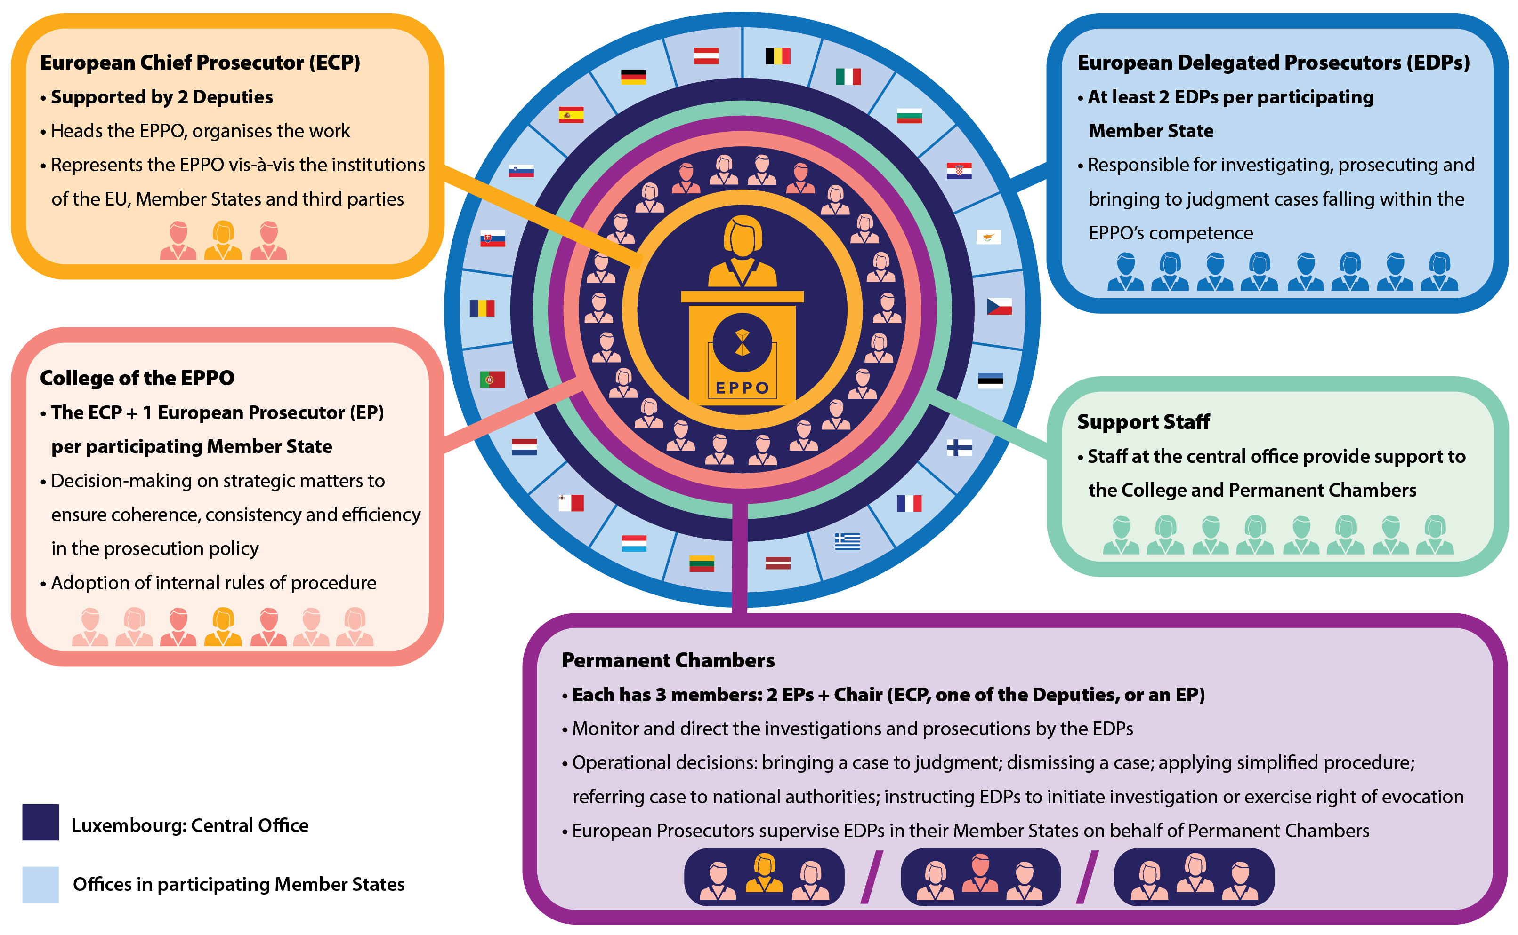
STRUCTURE OF EPPO

Slide 49
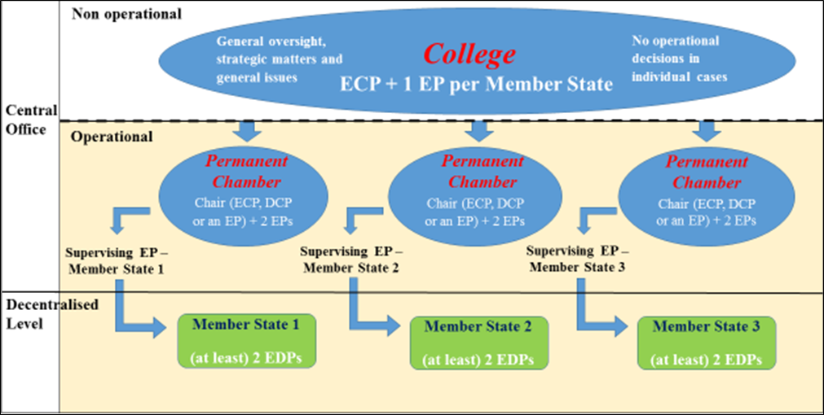
STRUCTURE OF EPPO
Notes:
Il livello centrale è composto da un ufficio centrale nella sede dell’EPPO. L’ufficio centrale è formato dal collegio,
dalle camere permanenti, dal procuratore capo europeo, dai sostituti del procuratore capo europeo, dai procuratori europei e dal direttore amministrativo.
Il collegio dell’EPPO è composto dal procuratore capo europeo e da un procuratore europeo per Stato membro.
Le camere permanenti sono presiedute dal procuratore capo europeo, o da uno dei sostituti del procuratore capo europeo, o da un procuratore europeo nominato presidente in conformità del regolamento interno dell’EPPO. Oltre al presidente, le camere permanenti dispongono di due membri permanenti. Il numero di camere permanenti e la loro composizione, nonché la ripartizione delle competenze tra le camere, tengono debitamente conto delle esigenze funzio­ nali dell’EPPO e sono determinati in conformità del regolamento interno dell’EPPO.
Ilcollegiosiriunisceperiodicamenteedèresponsabiledellasupervisionegeneraledelleattivitàdell’EPPO.
Adotta il regolamento interno.
Il procuratore capo europeo è al vertice dell’EPPO. Organizza il lavoro dell’EPPO, dirige le sue attività e adotta le decisioni in conformità del presente regolamento e del regolamento interno dell’EPPO.
2. Sono nominati due sostituti del procuratore capo europeo per assistere il procuratore capo europeo nell’esercizio delle sue funzioni e per sostituirlo in caso di assenza o impedimento.

Slide 50
EPPO INVESTIGATIONS
Exercise of competence
Ongoing investigation: power of avocation
Mitigated legality principle
Article 22
Start of investigation:
- EDP: solely national case
- More EDPs
Transnational case: Art. 31
End of investigation: 1.dismissal of case
2. exercise of criminal action
Final decision by the permanent chambers
Initiation of proceedings before the national court
Identification of EDP and relevant applicable national law
Reporting by national authorities
Notes:
È solo a seguito della positiva verifica della segnalazione ricevuta che l’indagine europea può iniziare15. Il termine tecnico adottato in pro-posito è quello di “esercizio della competenza”. Tale esercizio può av-venire con l’avvio dell’indagine da parte dell’EPPO (art. 26 Reg. EP-PO) o con l’avocazione da parte dell’dell’EPPO dell’indagine già av-viata a livello nazionale (art. 27 Reg. EPPO)16. Una volta esercitata la competenza, si entra nel contesto della con-duzione (“svolgimento”) dell’indagine europea (art. 28 Reg. EPPO), con il compimento da parte dell’EPPO (normalmente il PED, salvo il caso di incarico avocato dal procuratore europeo incaricato) delle misu-re investigative necessarie.
Vige un principio di legalità nell’avvio delle indagini per i reati con-tro gli interessi finanziari dell’Unione? In altri termini: se la segnalazio-ne non è infondata e assume i connotati di una effettiva notitia criminis, è obbligato l’EPPO (a livello nazionale o centrale) a far partire le inda-gini? La risposta è tendenzialmente positiva. Già il considerando n. 66 . del preambolo stabilisce che le indagini sono informate al principio di legalità, che viene pure ribadito nel successivo punto 81. Il Reg. EPPO recita poi che l’organo “avvia le indagini” (art. 26 Reg. EPPO), con formulazione lessicale chiaramente imperativa26

Slide 51
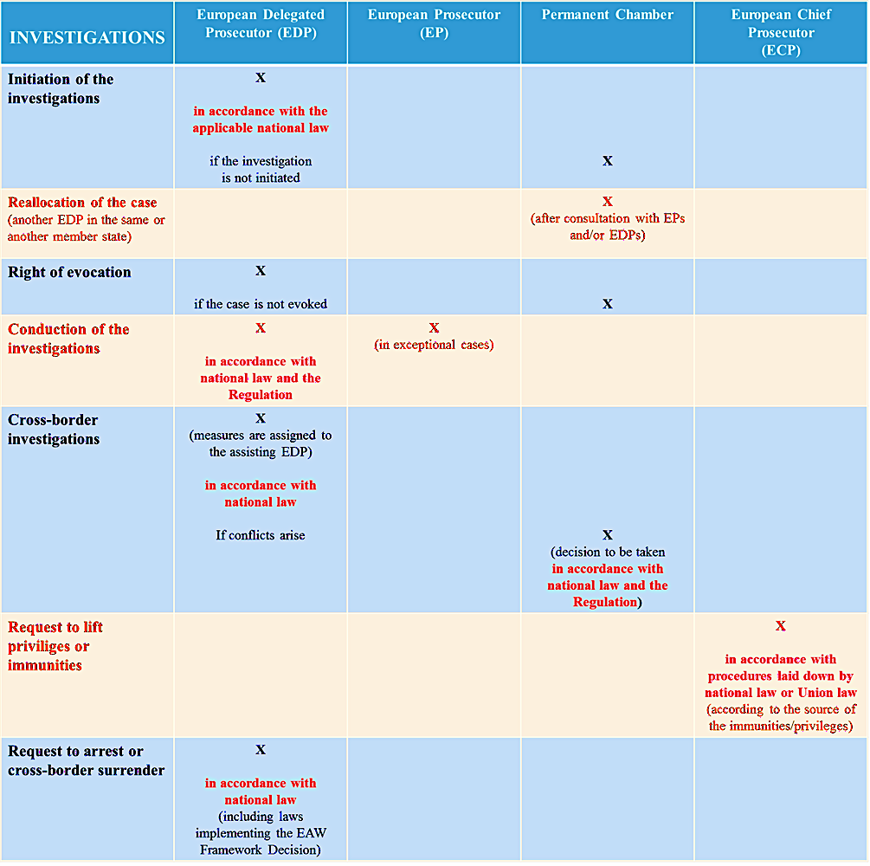

Slide 52
REPORTING AND INFORMING
Article 24(7): no grounds to investigate
EPPO shall inform:
National LEAs
Crime victims or people who reported
Duty to report
EPPO
Article 24(8)
EPPO discovers new offences outside its competence
EPPO informs NCAs and forward relevant infos
Duty to inform
EPPO exercises its competence (evocation)
Article 25(1) NCAs shall not exercise their own competence in respect of the same conduct
Preventive ne bis in idem

Slide 53
Pre-trial arrest and surrender
The handling EDP (or EP who took over investigation) may order or request the arrest or pre-trial detention in accordance with the national law
  Only suspects or accused persons, not witnesses etc.
If person is not present – EPD issue or request the competent authority of MS to issue a EAW
          Not automatically valid, relies on principle of mutual reccognition
        - or traditional extradition in third countries

Slide 54
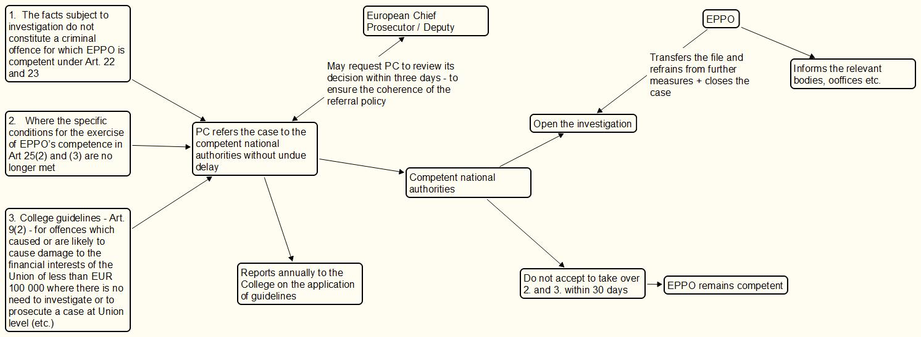
Referrals and transfers of proceedings (Art. 34)

Slide 55
INVESTIGATION MEASURES
At least in cases where the offence subject to the investigation is punishable by a maximum penalty of at least 4 years of imprisonment, Member States shall ensure that the European Delegated Prosecutors are entitled to order or request the following investigation measures:
(a) search any premises, land, means of transport, private home, clothes and any other personal property or computer system, and take any conservatory measures necessary to preserve their integrity or to avoid the loss or contamination of evidence;
(b) obtain the production of any relevant object or document either in its original form or in some other specified form;
(c) obtain the production of stored computer data, encrypted or decrypted, either in their original form or in some other specified form, including banking account data and traffic data with the exception of data specifically retained in accordance with national law pursuant to the second sentence of Article 15(1) of Directive 2002/58/EC of the European Parliament and of the Council ( 1 );
(d) freeze instrumentalities or proceeds of crime, including assets, that are expected to be subject to confiscation by the trial court, where there is reason to believe that the owner, possessor or controller of those instrumentalities or proceeds will seek to frustrate the judgement ordering confiscation.
(e) intercept electronic communications to and from the suspect or accused person, over any electronic communication means that the suspect or accused person is using;
(f) track and trace an object by technical means, including controlled deliveries of goods.

Slide 56
EPPO INVESTIGATIONS
Article 30(2): National law can impose some conditions
  MSs may limit the application of points (e) and (f) of paragraph 1 of this Article to specific serious offences.
Article 30(4): EDPs shall be entitled to request or to order any other measures in their Member State that are available to prosecutors under national law
Article 30(5): may only order the measures referred to in paragraphs 1 and 4 where:
  there are reasonable grounds to believe that the specific measure in question might provide information or evidence useful to the investigation
  there is no less intrusive measure available which could achieve the same objective
  The procedures and the modalities for taking the measures shall be governed by the applicable national law.

Slide 57
Cross-border investigations
EDP State (A)
If both MSs require judicial authorization for the measure in question, then both authorizations must be obtained. This ensures compliance with the legal requirements of both:
the Member State of the handling EDP,
and the Member State of the assisting EDP.
In such a situation, one authorization is not sufficient. This reflects the dual compliance principle enshrined in the EPPO Regulation: cross-border measures must respect the legal standards of both the issuing and executing jurisdictions.
This helps safeguard fundamental rights and legal certainty within the EU’s complex multilevel system.

Slide 58
Cross-border investigations
EDP State (B)
If the EDP requested to provide assistance considers that:
the assignment is incomplete or contains a manifest and significant error;
b) the measure cannot be carried out within the deadline set in the assignment for justified and objective reasons;
c) an alternative, less intrusive measure can achieve the same results as the assigned measure; or
d) the assigned measure does not exist or would not be available in a comparable national case under the law of their Member State;
they shall inform their Supervising European Prosecutor and consult the European Delegated Prosecutor in charge of the case to resolve the issue bilaterally.

Slide 59
Cross-border investigations
EDP State (B)
If the assigned measure does not exist in a purely internal situation but would be available in a cross-border situation governed by legal instruments of mutual recognition or cross-border cooperation, the European Delegated Prosecutors (EDPs) concerned, together with their Supervising European Prosecutors, may resort to such instruments.
If the EDPs cannot resolve the issue within seven working days and the assignment remains unchanged, the matter shall be referred to the competent Permanent Chamber.
The competent Permanent Chamber shall, as necessary, hear the EDPs and subsequently decide, without undue delay and in accordance with applicable national law and this Regulation, whether and within which timeframe the necessary measure, or a substitute measure, is to be adopted by the EDP requested to provide assistance. The Chamber shall communicate its decision to the aforementioned EDPs via the competent European Prosecutor.

Slide 60
CJEU, C-281/22, G.K.: first preliminary reference
A preliminary ruling was requested by the Oberlandesgericht of Vienna.
In a case investigating customs law violations, the German EDP needs to carry out searches in Austria. The German judge authorizes the searches.
The Austrian EDP is associated with the case file. According to Austrian law, a search ordered by the public prosecutor must be validated by a judge.
The persons under investigation challenge the Austrian judge’s validation, arguing that it should not have been granted due to lack of serious grounds for suspicion of the offense. They contend this is a matter of substance (merits) rather than a matter strictly related to the execution of the measure.

Slide 61
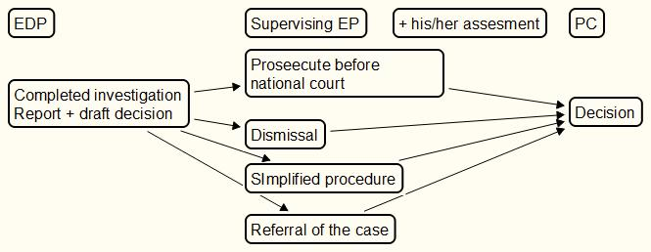
TERMINATION OF THE INVESTIGATION (ARTICLE 35)

Slide 62
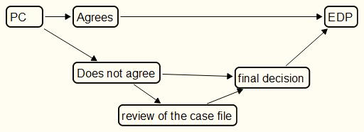
Decisions of the PC upon completion (ARTICLE 35)
Notes:
Centralised decisions - good for a unified policy of criminal persecution
EDP – less independent in deciding that in national legal systems

Slide 63
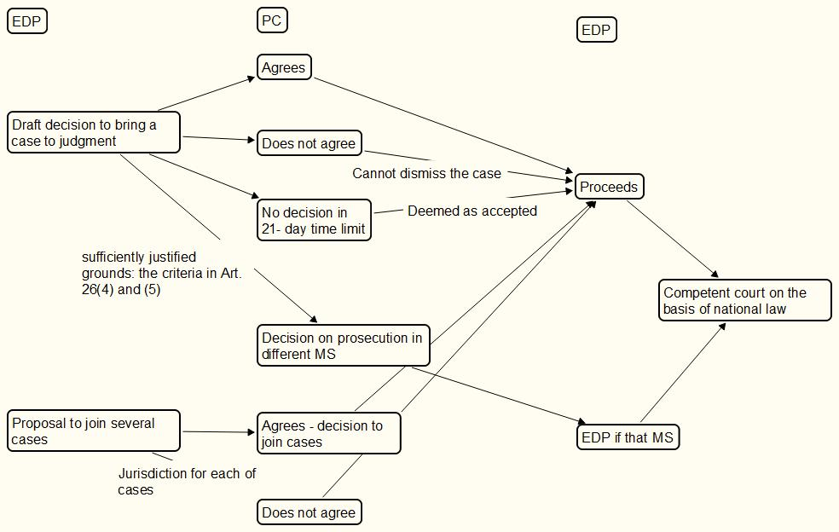
Prosecution before national courts (ARTICLE 36)

Slide 64
DEFENCE RIGHTS
Link with EU Directives:
41§2. Any suspected or accused person in the criminal proceedings of the EPPO shall, at a minimum, have the procedural rights provided for in Union law, including directives concerning the rights of suspects and accused persons in criminal procedures, as implemented by national law, such as:
(a) the right to interpretation and translation, as provided for in Directive 2010/64/EU;
(b) the right to information and access to the case materials, as provided for in Directive 2012/13/EU;
(c) the right of access to a lawyer and the right to communicate with and have third persons informed in the event of detention, as provided for in Directive 2013/48/EU;
(d) the right to remain silent and the right to be presumed innocent as provided for in Directive (EU) 2016/343;
(e) the right to legal aid as provided for in Directive (EU) 2016/1919.

Slide 65
Thank you for your attention!

