Slide 1


Presumption of innocence – Lights and Shadows
Online, 3 July 2025
Dr. Lorenzo Bernardini
Postdoctoral Researcher in Criminal Law,
University of Luxembourg

Slide 2
Introduction to the Directive 2016/343 on the presumption of innocence

Slide 3

A composite legal framework (I)
Article 48 of the Charter of Fundamental Rights
1. Everyone who has been charged shall be presumed innocent until proved guilty according to law.
2. Respect for the rights of the defence of anyone who has been charged shall be guaranteed.
How to fill the scope and meaning of those expressions?
Similar rights are laid down in the European Convention on Human Rights
Article 6(2) ECHR – right to be presumed innocent
Article 6(3) ECHR – rights of the defence

Slide 4

A composite legal framework (II)
Article 52(3) of the Charter (homogeneity clause)
the meaning and scope of the rights set out in the Charter that correspond to rights guaranteed by the ECHR must be the same as those laid down by the correlating article of the ECHR
Presumption of innocence
Rights of the defence
Article 48(1) of the Charter
Article 6(2) ECHR
Article 48(2) of the Charter
Article 6(3) ECHR
The CJEU can ignore the ECtHR case-law but only in order to provide a higher level of protection than that guaranteed by the ECHR

Slide 5
A composite legal framework (III)
Presumption of innocence
Directive (EU) 2016/343 – presumption of innocence
Rights of the defence
(i) Directive 2010/64 – right to interpretation and translation;
(ii) Directive 2012/13 – right to be informed;
(iii) Directive 2013/48 – right of access to a lawyer
(iv) Directive 2016/1919 – right to legal aid;
(v) Directive 2016/343 – right to silence and to be present at trial
(vi) Directive 2016/800 – procedural safeguards for children

Slide 6
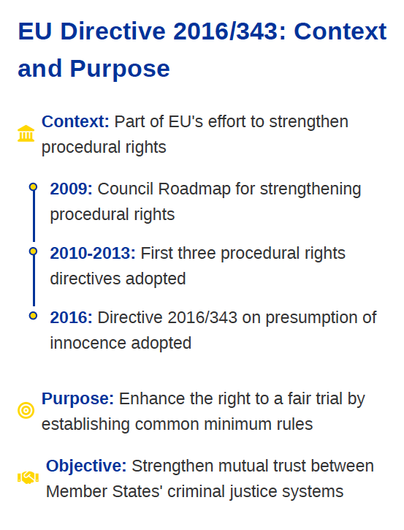
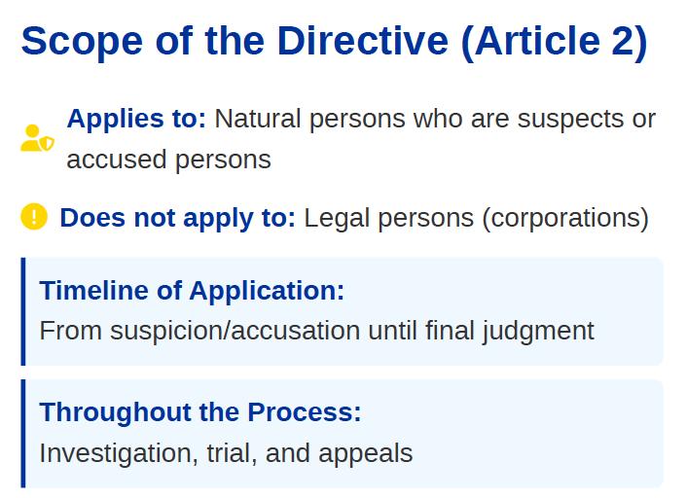
A composite legal framework (IV)
Directive (EU) 2016/343 – presumption of innocence

Slide 7
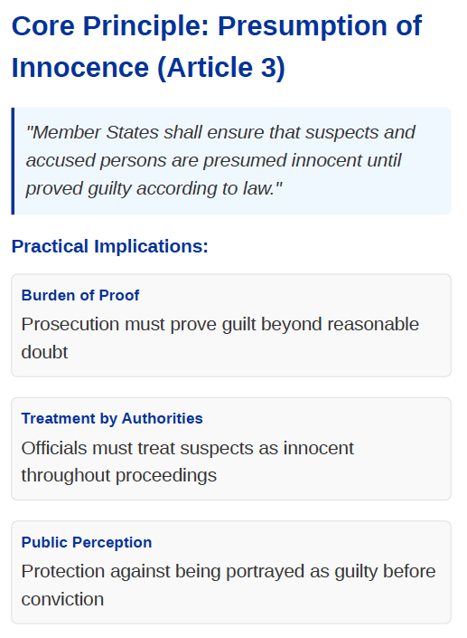
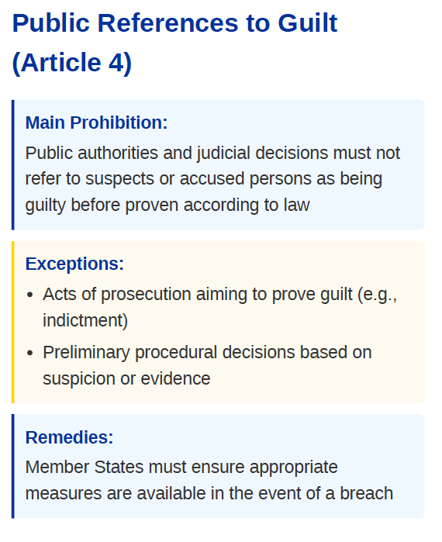
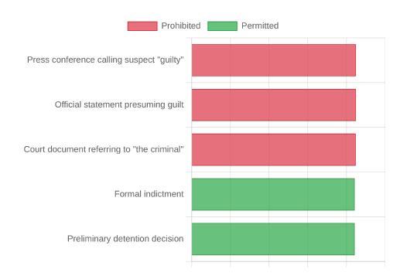
A composite legal framework (V)

Slide 8
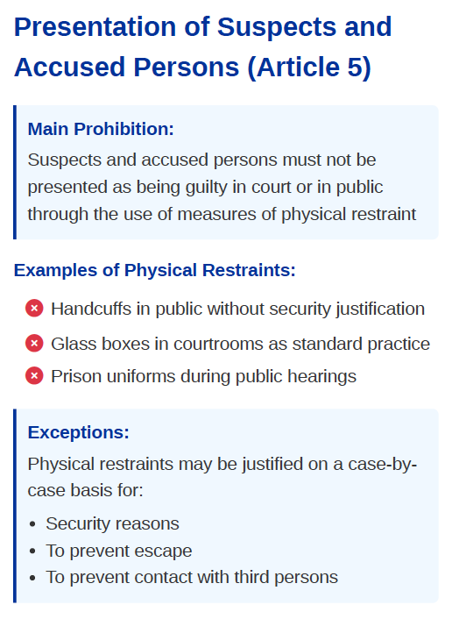
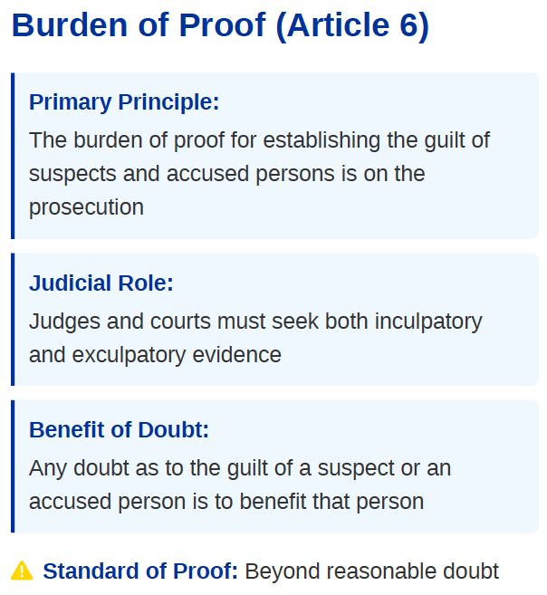
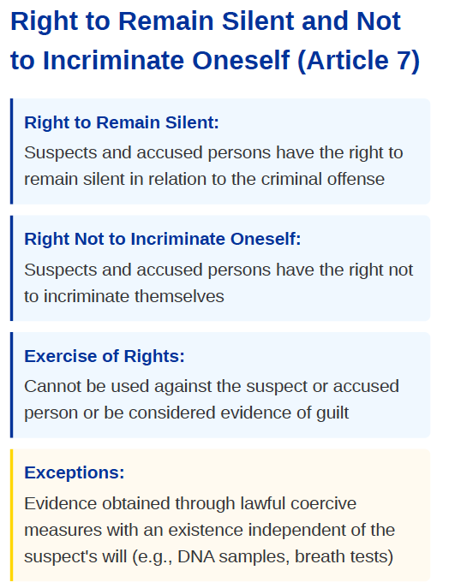
A composite legal framework (VI)

Slide 9
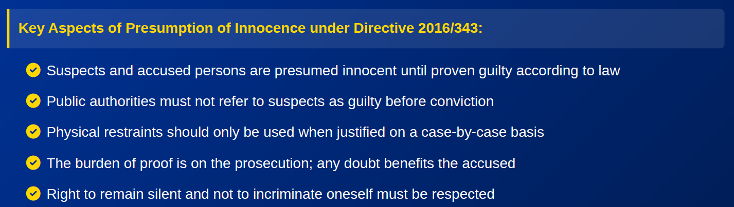
A composite legal framework (VII)

Slide 10
The pre-trial detention and the principle of presumption of innocence – Lack of harmonization?

Slide 11
Pre-trial detention and presumption of innocence
(Case C-310/18 PPU – Milev)
The facts
Mr Milev is prosecuted in Bulgaria;
He has been detained on remand;
Before the trial court, he applied to be released.
Legal issues
Domestic requirement for pre-trial detention (PTD) is the existence of “reasonable grounds” for having committed a criminal offence – is this to be understood as a mere prima facie finding or as a “strong likelihood” in light of presumption of innocence?
Can a court merely state the reasons for its decision on PTD
without comparing the incriminating and exculpatory evidence,
even if the accused’s lawyer has submitted arguments to that effect?

Slide 12
EU provisions at stake
Article 3 of Directive 2016/343 – suspects/accused persons are presumed innocent until proven guilty according to law;
Article 4 of Directive 2016/343 – judicial decisions cannot refer to suspect or accused persons as guilty, without prejudice to preliminary decisions which are based on suspicion or an incriminating evidence, until that person has been proven guilty according to law

Slide 13
Request for a preliminary ruling
whether Article 3, Article 4(1) Directive 2016/343 in light of Articles 47 and 48 of the Charter implies that, when deciding on the grounds for PTD, a judge shall assess that prima facie the accused person may have committed the offence in question, or, differently, that there is a strong likelihood in this regard;
whether those provisions entails that a national court ruling on an application to modify a PTD measure may state reasons for its decision without comparing the incriminating and exculpatory evidence, or rather that that court should furnish a clear response to the arguments submitted by the person detained.
Opinion of the AG
Where exculpatory evidence does not appear implausible, it is for the judge examining an appeal against PTD to take that evidence into account together with the incriminating evidence in order to assess whether there are reasonable suspicions that that person committed the offence at stake

Slide 14
Reasoning
Articles 3 and 4 of the Directive in light of Recital 16 require that decisions on PTD shall not present the suspect as being guilty;
Judicial authorities have to verify that there is a sufficient incriminating evidence against the person concerned to justify a PTD decision, specifically referring to that evidence;
However, the Directive aims only at laying down mininum standards – it does not regulate all the conditions for the adoption of decisions on PTD;
PTD decisions may be adopted by Member States, provided
that they do not present the suspect as being guilty

Slide 15
Reasoning
Still, the circumstances in which decision on PTD may be adopted – e.g., the degree of certainty that the person concerned committed that offence, or the rules governing examination of evidence – is a matter that falls solely within the remit of domestic law.
The ruling
Article 3 and Article 4(1) of Directive (EU) 2016/343 does not preclude the adoption of PTD decisions, which are based on incriminating evidence, provided that such decisions do not refer to the person in custody as being guilty.
However, that directive does not govern the circumstances
in which decisions on pre-trial detention may be adopted.

Slide 16
Burden of proof, pre-trial detention and presumption of innocence (Case C-8/19 PPU – RH)
The facts
RH is prosecuted in Bulgaria;
He has been detained on remand;
He has now contested his continued detention – the court has to decide whether there are still reasonable grounds to suspect him
Legal issues
The referring judge struggles to justify detention based on incriminating evidence without violating the presumption of innocence (i.e. so that RH is not presented as guilty, while at the same time responding to the objections put forward by his defence counsel);
Bulgarian (case-)law obliges courts to adjudicate without
waiting for the reply to a preliminary ruling; a disciplinary
sanction may be imposed for delays.

Slide 17
EU provisions at stake
Article 267 TFEU: right of national courts to refer preliminary questions.
Article 47(2) Charter: right to a decision within a reasonable time.
Directive 2016/343, especially: Article 4 ⟶ No public reference to guilt; Article 6 ⟶ Burden of proof on prosecution; Recital 16 ⟶ Pre-trial detention can refer to incriminating elements, but not present someone as guilty.
Request for a preliminary ruling
(1) ‘Whether national law (Art. 489(2) NPK), which obliges courts to rule on pre-trial detention without waiting for the CJEU's reply to a preliminary question, is compatible with Article 267 TFEU and Article 47(2) of the Charter’
(2) ‘Whether, under Directive 2016/343, the national court:
  must verify that there is sufficient incriminating evidence before extending detention;
  must respond to defence objections about the lack of such evidence;
  infringes EU law if it bases detention decisions on ECtHR case-law while clearly identifying incriminating elements”

Slide 18
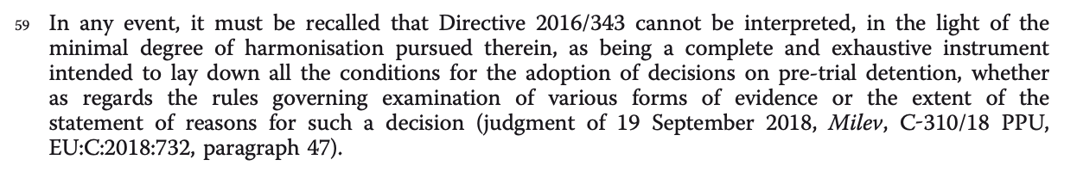
Reasoning
National courts must be free to make a preliminary
reference and wait for an answer (Art. 267 TFEU).
Disciplinary sanctions for doing so undermine
judicial independence.
Directive 2016/343 does not regulate national rules on PTD but:
  Decisions can rely on incriminating evidence, if no reference to guilt is made;
  Judges may weigh inculpatory and exculpatory evidence, and respond to defence objections;
  These procedural acts do not violate the presumption of innocence.
Procedural autonomy is preserved within the limits set by EU law.
Opinion of the AG
Not applicable – the Court ruled by reasoned order (Article 99 Rules of Procedure)

Slide 19
The ruling
Article 267 TFEU and Article 47(2) Charter:
  National law cannot prevent or sanction a court for referring a question or waiting for a reply.
Articles 4 and 6 of Directive 2016/343:
  Do not preclude pre-trial detention decisions based on incriminating evidence;
  Courts can give reasons and respond to the defence, as long as no declaration of guilt is made.
The allocation of the burden of proof in PTD remains under national law, but must respect the Charter and Directive 2016/343.

Slide 20
Burden of proof, pre-trial detention and presumption of innocence (Case C-653/19 PPU – DK)
The facts
DK is prosecuted in Bulgaria;
He has been detained on remand;
Before the trial court, he applied to be released.
Legal issues
In Bulgaria, the trial court verifies whether the detention is lawful – if so, detention continues for an indefinite period of time;
The court cannot subsequently examine the issue of its own motion (motu proprio);
It will be for the accused person to prove the existence of
new circumstances justifying their release.
The domestic court doubts as to whether the allocation of the
burder of proof is compatible with the presumption of innocence

Slide 21
EU provisions at stake
Article 6 of Directive 2016/343 – the burden of proof for establishing the guilt of suspects and accused persons is on the prosecution;
Request for a preliminary ruling
‘Is a national law that requires a change in circumstances as a condition for granting the release of the accused person from detention, consistent with Article 6 and recital 22 of Directive 2016/343 and with Articles 6 and 47 of the [Charter]?’
Opinion of the AG
Article 6 of the Directive does not apply to PTD proceedings

Slide 22
Reasoning
Articles 3 and 4 of the Directive require that decisions on PTD shall not present the suspect as being guilty;
Article 6 of the Directive governs the allocation of the burden of proof only in the adoption of judicial decision on guilt;
A decision on PTD cannot be considered a decision on the guilt of the accused person;
Thus, Article 6 of the Directive does not apply;
The allocation of the burden of proof can be regulated
by Member States (procedural autonomy)

Slide 23
The ruling
Article 6 of Directive 2016/343 and Articles 6 and 47 of the Charter of Fundamental Rights of the European Union do not apply to a national law that makes the release of a person held in PTD pending trial conditional on that person establishing the existence of new circumstances justifying that release.
The consequence
The allocation of the burden of proof in domestic PTD proceedings
will remain within the remit of national law.

Slide 24
Safeguards in relation to parallel criminal proceedings

Slide 25
Plea bargain and presumption of innocence
(Case C-338/20 – AH and others)
The facts
Six individuals (MH and others) are prosecuted for their membership of a criminal organization;
MH concluded an agreement with the prosecutor – admission of guilt in exchange of a reduced sentence;
Admission to be part of a criminal organization, together with the other five people who, however, did not admit their guilt;
Legal issues
Is such an agreement compatible with the presumption of innocence?

Slide 26
EU provisions at stake
Article 4(1) of Directive 2016/343 – as long as a suspect/accused person has not been proved guilty judicial decisions, other than those on guilt, do not refer to that person as being guilty”
Request for a preliminary ruling
“whether Article 4(1) of Directive 2016/343 precludes an agreement, in which the accused person admits his guilt in exchange for a reduced sentence that expressly mentions as joint perpetrators of the criminal offence at issue not only that person, but also the other accused persons, who did not admit their guilt”
Opinion of the AG
- Such agreement is compatible with EU law provided that:
(i) references to other accused persons are necessary for identifying the legal characterization of the offence;
(ii) it is clearly stated that those persons are being prosecuted in separate criminal proceedings and their guilt has not yet been determined by law

Slide 27
Reasoning
Directive 2016/343 is applicable – The defendants are suspects in criminal proceedings
Article 48(1) of the Charter corresponds to Article 6(2) ECHR – relevance of the ECtHR’s case-law as a minimum benchmark;
Karaman v. Germany (ECtHR, 2014):
  the “choice of words” in judicial decisions is pivotal;
  decisions on the participation of third persons are not per se unlawful, but they shall provide only that information necessary to assess the criminal liability of the person concerned – it shall not become a “pre-judgment” on other persons.

Slide 28
The ruling
Article 4(1) of Directive 2016/343 does not preclude an agreement wherein an accused person admits guilt in exchange for a reduced sentence, even if the agreement explicitly identifies other accused individuals as joint perpetrators of the same offense, provide that:
that reference is necessary for the categorisation of the legal liability of the person who entered into the agreement
and, second, that that same agreement makes it clear that those other persons are being prosecuted in separate criminal proceedings and that their guilt has not been legally established.

Slide 29
Can a company be fined on the basis of a pending indictment? (Case 203/21 – DELTA STORY 2003)
The facts
Delta Stroy 2003, a Bulgarian company, was prosecuted in separate proceedings for a financial penalty tied to a VAT offence allegedly committed by its representative (ZK). ZK was charged with evading approx. €5,800 in VAT.
While the criminal proceedings against ZK were still pending, the company itself was sanctioned under Bulgarian law (ZANN), based on the alleged advantage it gained from the offence.
Under Bulgarian law (Art. 83a ZANN), a legal person can be penalized without the representative being convicted first.
Legal issues and request for a preliminary ruling
Can a financial penalty be imposed on a company for an offence not yet established (i.e., pending proceedings against the natural person)?
Is it lawful to fix such a penalty at the amount of the benefit allegedly derived, even if the underlying offence has not been established?
Is such a penalty to be considered as a ‘confiscation’ measure according to EU law?

Slide 30
EU provisions at stake
Article 48 of the Charter – presumption of innocence;
Directive 2014/42/EU (on confiscation)
Framework Decisions 2005/212/JHA and 2005/214/JHA (confiscation and financial penalties)
Opinion of the AG
The financial penalty imposed on the legal person is of a criminal nature, thus EU fundamental rights under Articles 47–49 of the Charter apply.
He emphasized the right of legal persons to fundamental rights.
He distinguished between financial penalties and confiscation, finding that the Bulgarian penalty system does not qualify as confiscation under EU law.
He accepted that the offence could be imputed to the company based on the acts of its representative, but only if there are adequate procedural safeguards.
However, he found the second presumption (that the offence was committed) problematic if it precludes the company from effectively defending itself before the penalty is imposed.

Slide 31
Reasoning
Not a confiscation case
  The penalty imposed is not a “confiscation” under Directive 2014/42 or Framework Decision 2005/212.
  It’s a criminal penalty under domestic law.
Role of fundamental rights
  Since the matter concerns VAT (an EU resource), EU law applies, and the Charter is fully applicable (Åkerberg Fransson doctrine).
  Article 48 of the Charter (presumption of innocence, rights of defence) is at the core.
Breach of presumption of innocence
  In Bulgaria – alegal person could be penalized without a prior conviction of the representative.
  The court cannot assess whether the offence was actually committed; it assumes the truth of the accusation.
  The company cannot effectively dispute the accusation or present a full defence – no meaningful remedy is offered.
Disproportionate interference
  Even if protecting EU financial interests is a legitimate goal, the means must be proportionate.
  This system overrides procedural safeguards and amounts to a manifest violation of Article 48 Charter.

Slide 32
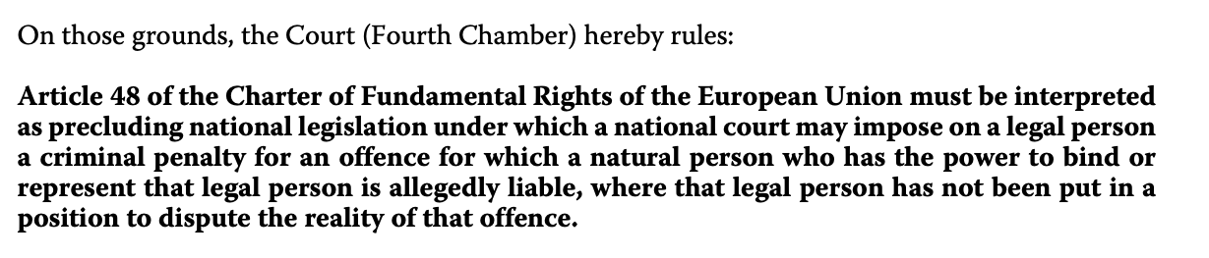
The ruling

Slide 33
Thank you for the attention!
Dr. Lorenzo Bernardini
Postdoctoral Researcher in Criminal Law
University of Luxembourg
lorenzo.bernardini@uni.lu

